Slide 1

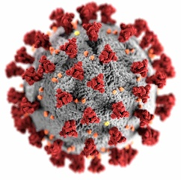
COVID-19 in the USA
An investigation into the risk of Covid 19 associated deaths within the United States of America

Slide 2
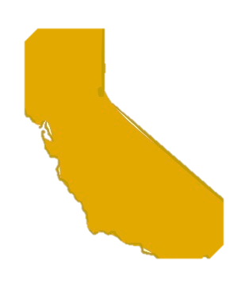
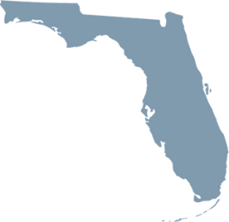
How I got interested in this study
There have been many arguments saying that California is doing very well because of mask mandates, vaccination rates and shutdown procedures done in the wake of SARS-CoV-2
On the other hand critics have said the opposite and that Florida should be the model state for it’s allowance of freedom and the fact that they have less cases than overbearing states like California

Slide 3
My question s
Which states and counties are doing better with managing COVID-19?
Can we predict how bad covid risks and death will be in each state/county?

Slide 4
Sources of data
Datahub.io/core/covid-19#data
A collection of data from
John’s Hopkins University,
The World Health Organization,
United States Center of Disease control, The COVID Tracking Project,
NYC Department of Health,
Florida Department of Public health
… and many others
The United States CDC Covid 19 database
Vaccination rates per county in the USA
The US Census
2021 Data on current US population per county
Wikipedia
Information about populations and locations of various counties within the US

Slide 5
Data
3342 different counties and municipalities in the United States
Daily COVID cases and deaths from January 1 2020-2022
Vaccine records from January 1 2021-2022
Includes Partial, Booster and Complete vaccinations per county and % of each county covered
Longitude and Latitude data for each county/municipality
Populations for each county/municipality & state
Includes total population and population density

Slide 6
Data cleaning and structuring

Slide 7
Data cleaning and structuring
Issues found with data while cleaning and arranging
Mortality rate deaths/cases was not a useful metric as some data had more deaths than cases yielding over 100% mortality rate in some counties
There is possibly a reporting error in some counties, under reporting of cases and/or over reporting of deaths. It’s impossible to be sure which.
Fix: Don’t use cases and death rates to predict mortality, but treat them as independent variables.
Population data was out of date for some of the COVID files
Fix: use more recent US census data for populations of counties and states.
Issue: some of the counties were not represented in the original Census data
Fix: worldpopulationreview.com provided missing data
Longitudinal data not present for each county
Wikipedia and google searches provided location of missing locations

Slide 8
Data cleaning and structuring
Some data listed counties as “name county”, some just “name”, still others are not counties but parishes, boroughs or municipalities.
Created replacement strings to standardize names to not include if perish/municipality/Burrough
Also some data included cities which are unincorporated or are their own county
Added in locational and population data for major populated cities/areas which were present in all the data and dropped the rest.
Some states were listed as their name other data listed states as their two letter postal abbreviations
A merging with a list of abbreviations and the state names was needed to put the data together.
Notes:
Other things I learned. Chuncking is key for getting big sets of data from an API w/o errors and waiting tens of minutes.

Slide 9
Data cleaning and structuring
I used linear interpolation back fill method helped fill NaN values in total cases in counties which started collecting data late.
Groupby methods for Pandas dataframes helped make predictive averages by state and allow for populational data to be merged by state and county when time course data was present.
Chunking data imports helped reduce the time it took from API’s.

Slide 10
Exploratory analysis

Slide 11
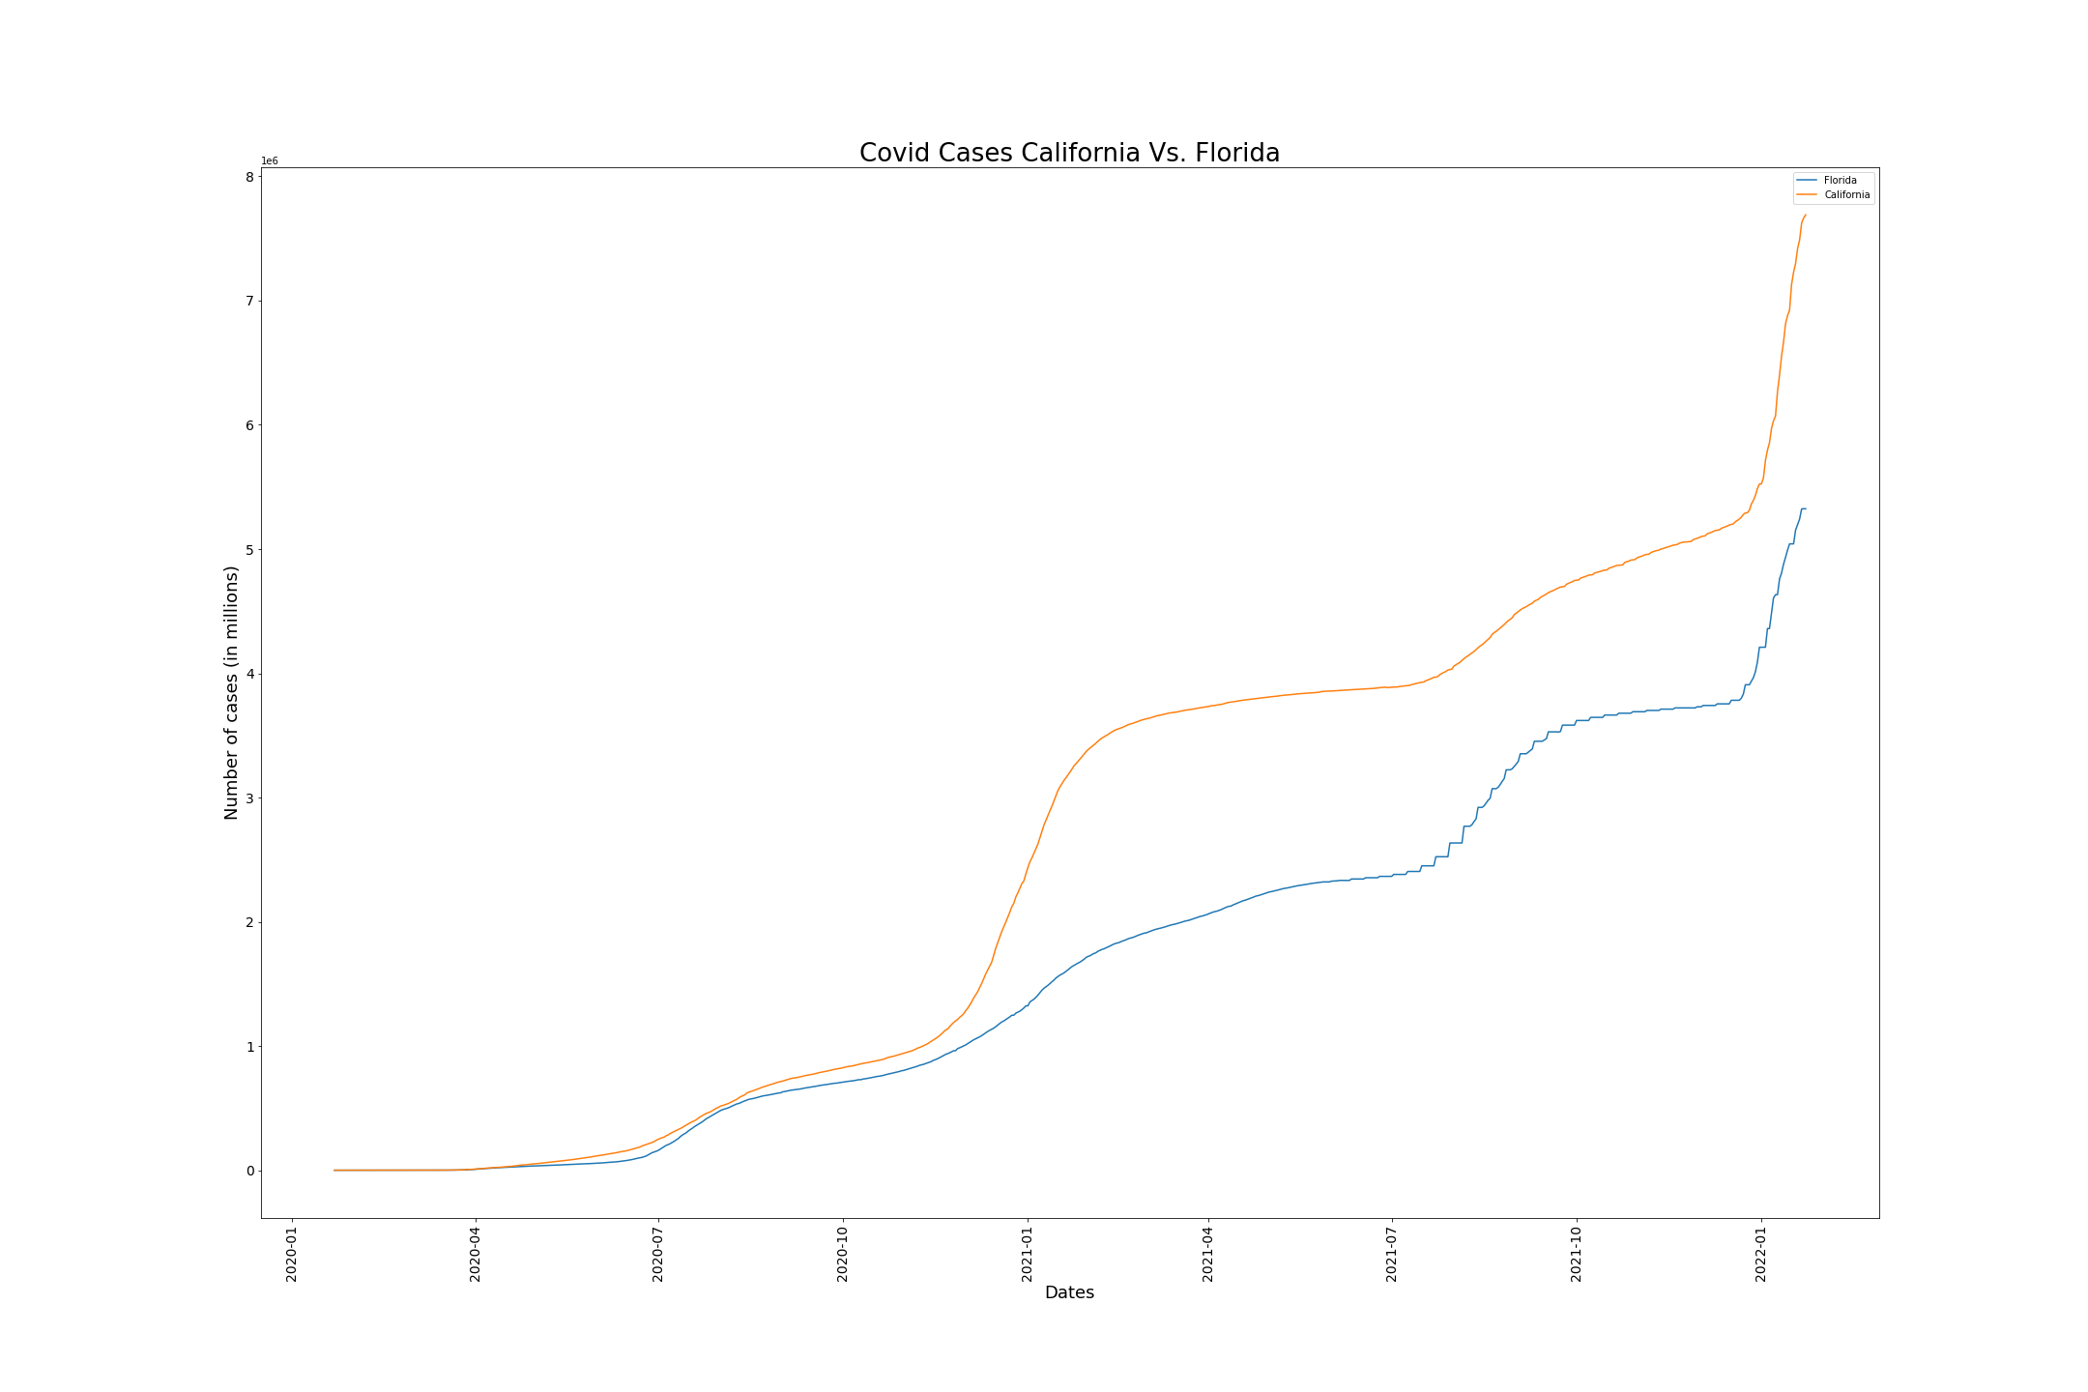
California vs Florida
But Populations:
CA = 39.5 Million
FL = 21.5 Million

Slide 12
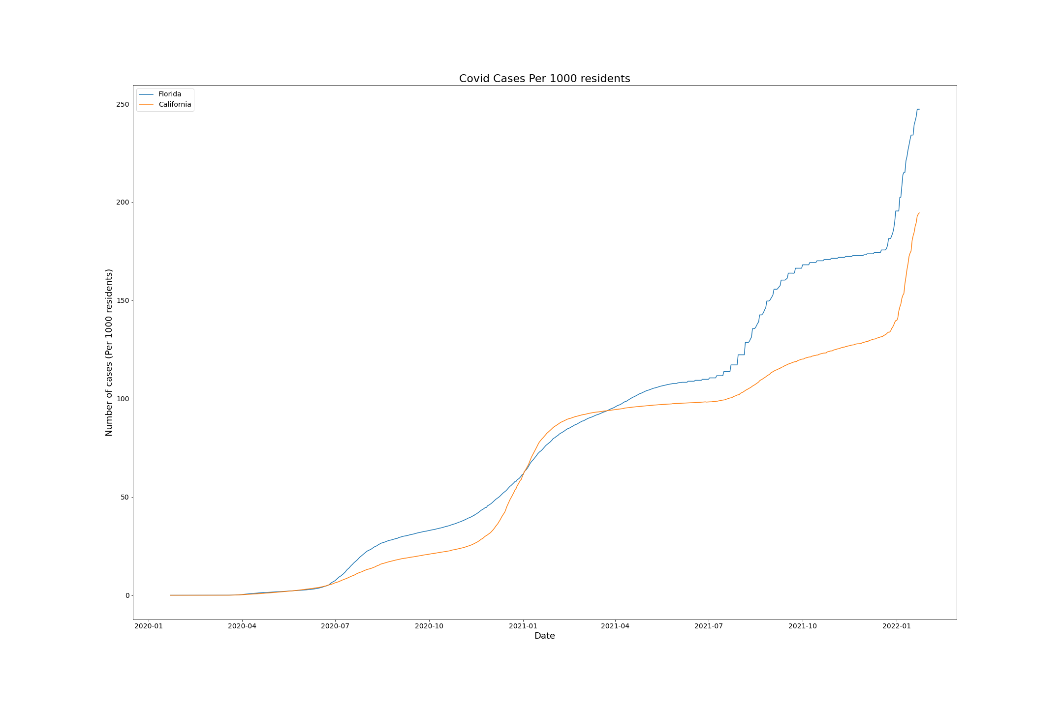
Total Cases of COVID 19 CA vs FL by Population
Per pop CA
Appears to be
Doing better

Slide 13
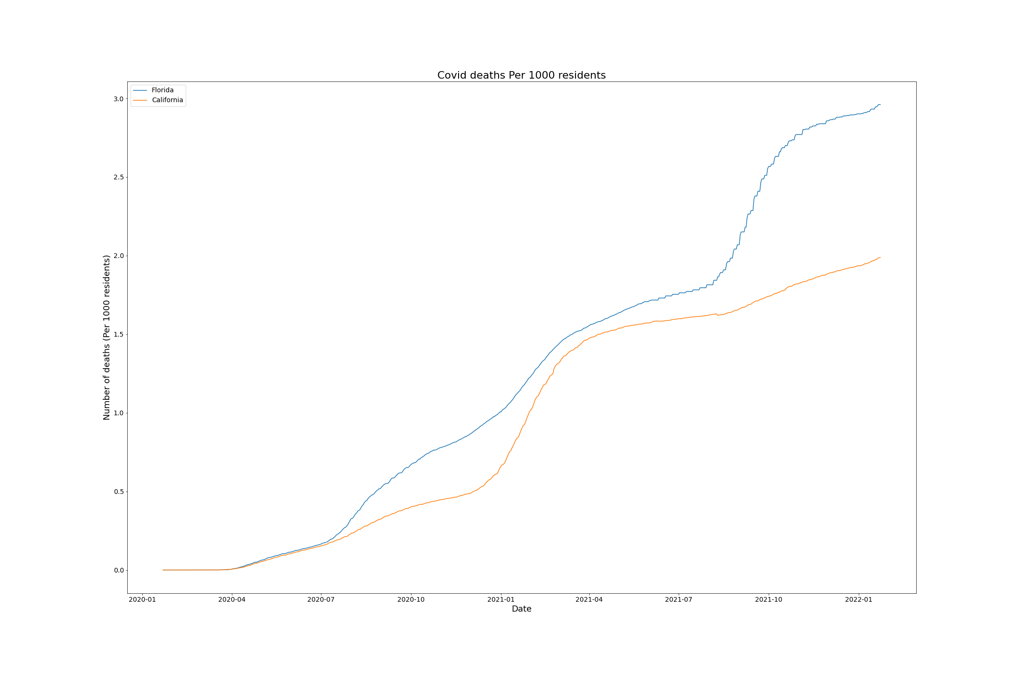
Total Deaths in CA vs FL by Population
150% more deaths
In FL per 1000 people
Than in CA

Slide 14
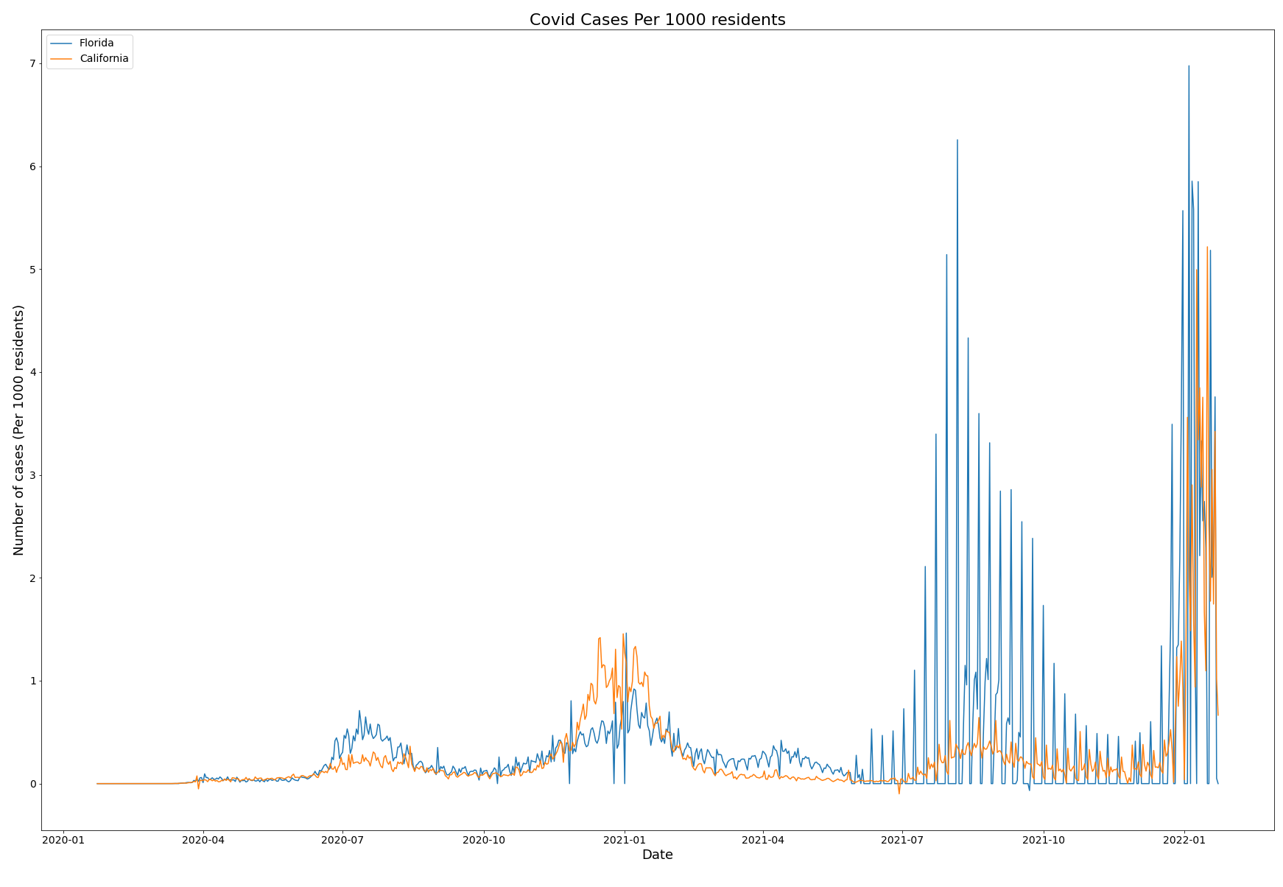
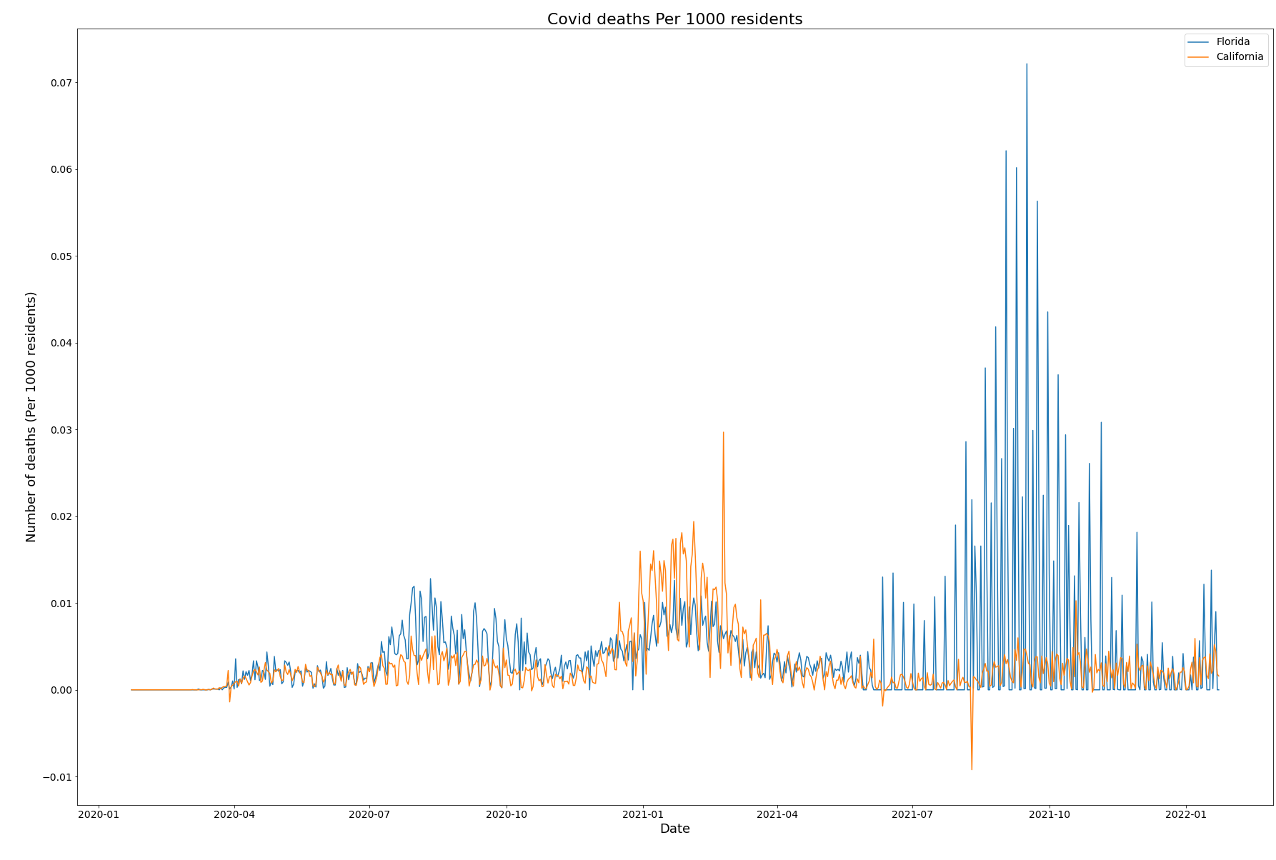
Daily Tally of Cases and Deaths California vs Florida per 1000 Residents
Vaccines
Delta
Omicron
Vaccines
Delta
Omicron
Alpha
Shutdown
Alpha
Shutdown

Slide 15
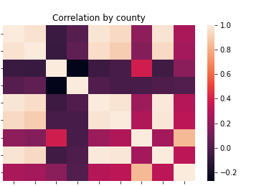
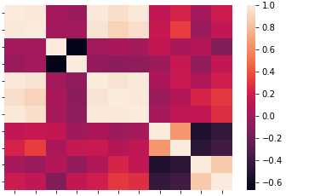
Correlational data shows high correlation between number of cases and deaths
Correlations by State
Confirmed
Deaths
Lat
Longitude
Total_Pop
Booster Booster pct
Complete
Complete pct
Confirmed
Deaths
Lat
Longitude
Total_Pop
Booster Complete
Confirmed Pct
Deaths Pct
Booster Pct
Complete Pct
Confirmed
Deaths
Lat
Longitude
Total_Pop
Booster Booster pct
Complete
Complete pct
Confirmed
Deaths
Lat
Longitude
Total_Pop
Booster Complete
Confirmed Pct
Deaths Pct
Booster Pct
Complete Pct
Notes:
Legends are cut off
Fix them or replace them with text

Slide 16
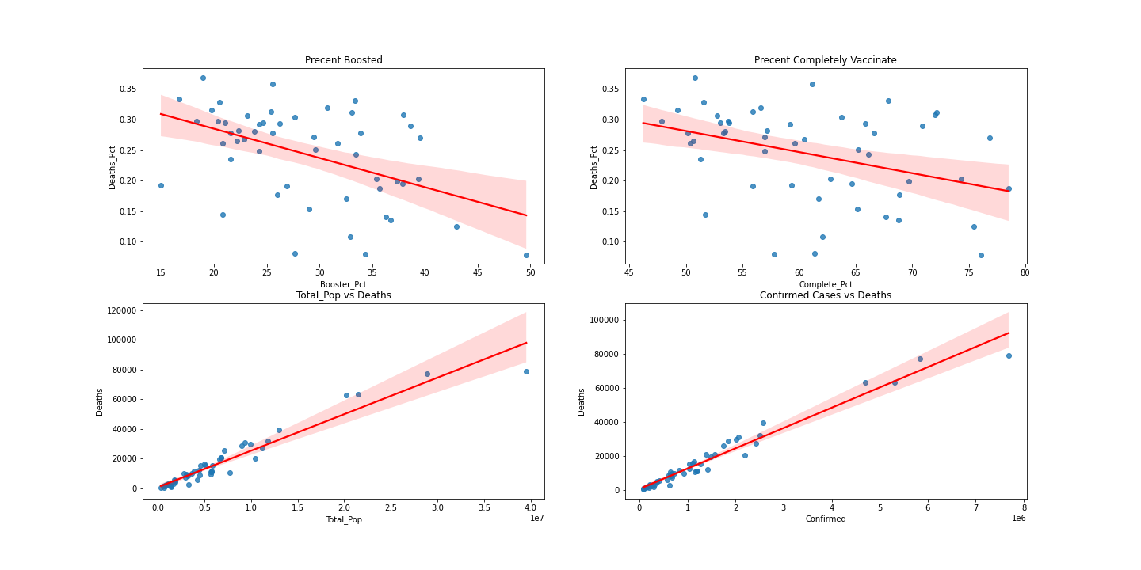
Correlations between Vaccination rates and population rates
Precent Boosted
Precent Completely Vaccinated

Slide 17
Clustering Analysis

Slide 18
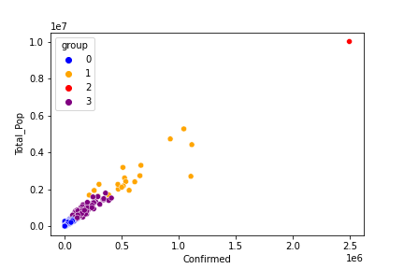
KNN Clustering

Slide 19
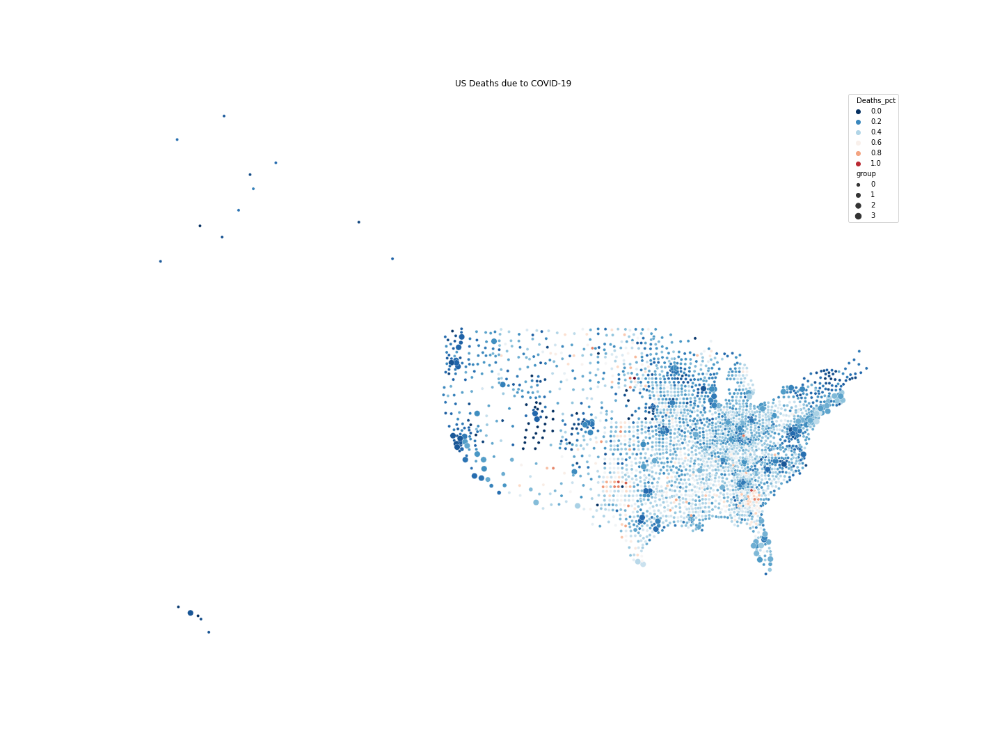
Deaths in the US by County
Notes:
Explain that Grouping has to do with Population size.
Maybe have a zoomed in version w/o Alaska and Hawaii?

Slide 20
Deaths in the US by County
Notes:
Explain that Grouping has to do with Population size.
Percentage of deaths by population is skewed. There appears to be an error in number of cases per population, perhaps in these small counties either there is poor reporting of the number of residents or individuals are counted more than once.
Either way the smaller counties and ones in the more southern and central American States are struggling more with COVID

Slide 21
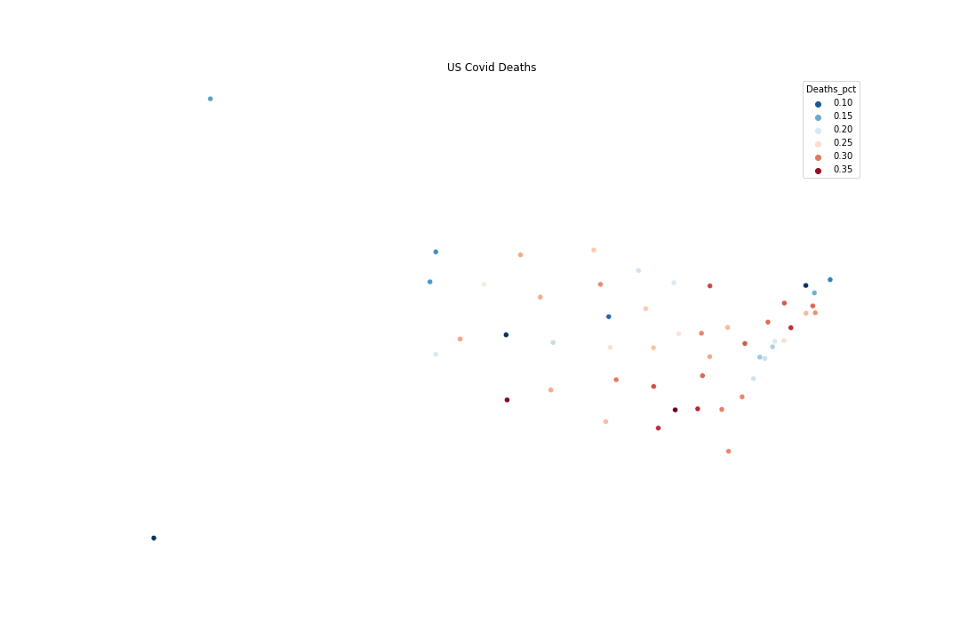
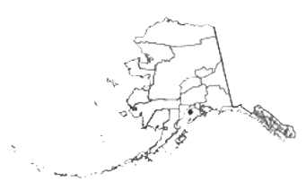
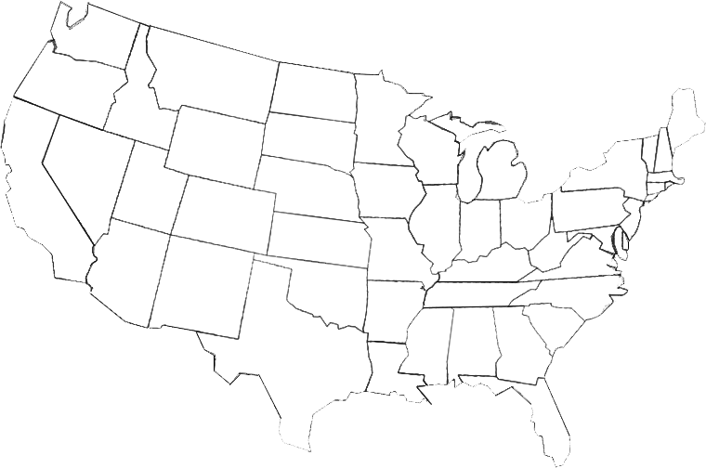
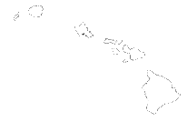
Deaths in the US by State
Notes:
States don’t align with the images that I’ve found.

Slide 22
Regression analysis
K Means Clustering shows us that the data does fall into groups of states/counties which are having different success rates with COVID-19
KNN Regression analysis was tried to see if we could predict the number of deaths in a state based on the defined features

Slide 23
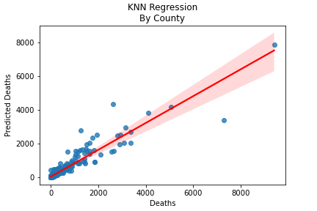
Regression Analysis
KNN Score is 0.8739
Giving us nearly 88% accuracy

Slide 24
Time series analysis
In addition to the data from each state we also have time series data which we could use to predict the outcome of COVID in each state
The data was first made stationary for the analysis
Then a 10 day forecast was predicted to determine if we could predict how COVID would be affecting any particular state

Slide 25
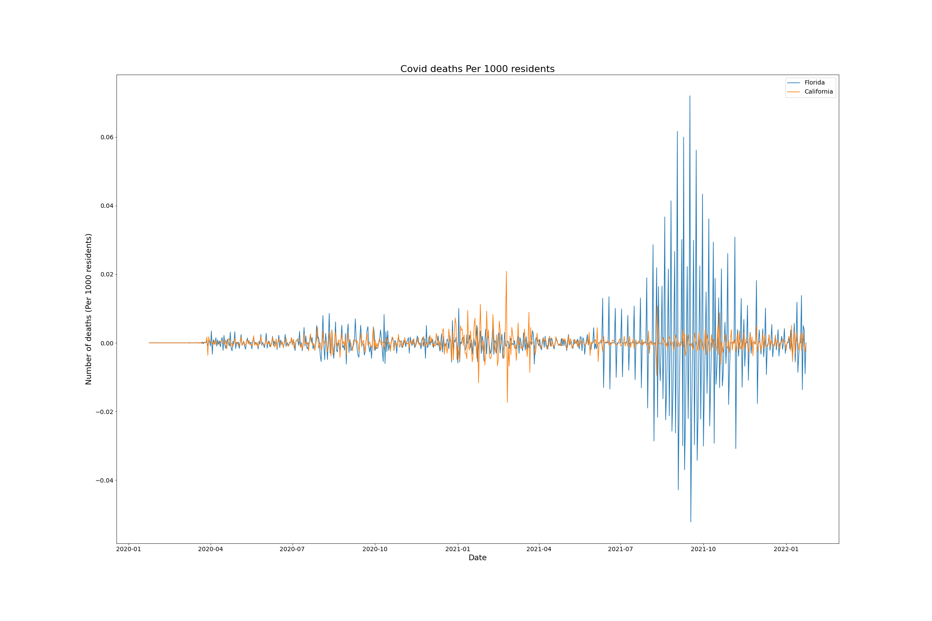
Example of reducing Florida and California data to stationary data

Slide 26
SARIMA Parameters
SARIMAX Results
==============================================================================
Dep. Variable: mov_avg No. Observations: 733
Model: ARIMA(6, 0, 0) Log Likelihood -6330.950
Date: Tue, 26 Apr 2022 AIC 12677.901
Time: 12:34:26 BIC 12714.678
Sample: 01-22-2020 HQIC 12692.087
- 01-23-2022
Covariance Type: opg
==============================================================================
coef std err z P>|z| [0.025 0.975]
---------------------------------------------------------------------------------------------------------------------------------
const 1.031e+04 5575.694 1.850 0.064 -614.065 2.12e+04
ar.L1 0.9927 0.015 64.436 0.000 0.962 1.023
ar.L2 0.0586 0.021 2.848 0.004 0.018 0.099
ar.L3 0.3854 0.021 18.297 0.000 0.344 0.427
ar.L4 -0.4385 0.027 -16.281 0.000 -0.491 -0.386
ar.L5 0.3506 0.021 16.566 0.000 0.309 0.392
ar.L6 -0.3711 0.013 -27.497 0.000 -0.398 -0.345
Sigma2 2.19e+06 678.998 3225.552 0.000 2.19e+06 2.19e+06
===================================================================================

Slide 27
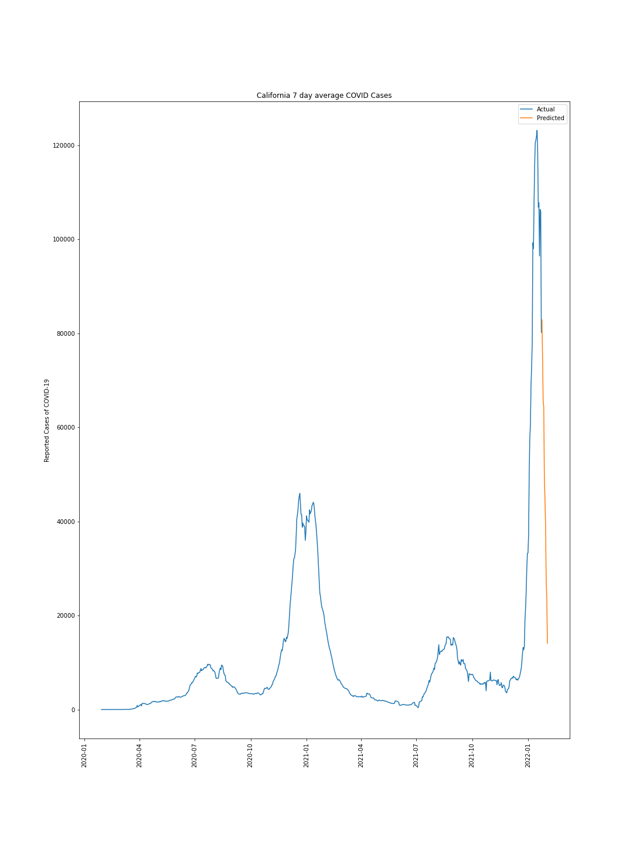
Prediction of California based on 7 day averages

Slide 28
Conclusions

Slide 29
What our data can do
We can predict via KNN Regression the number of deaths associated with SARS-CoV-2 in each state and county based on population, vaccination and number of cases with nearly 88% accuracy
Data for each county seems to have some flaws in calculating actual percentage of individuals who die from COVID-19
Possible reasons:
Additional comorbidities
Individuals getting COVID more than once
Availability of medical treatments may vary in each county/state
Time series analysis seems possible but still needs more work
Vaccination data not incorporated into current time series data
Additional data like dates and compliance with masking and gathering may influence data
For instance temperatures within each county may force people either indoors our outdoors and thus increase their likelihood of transmitting COVID-19

Slide 30
What does our data tell us
There is a correlation between population size and SARS-CoV-2 infection and COVID-19 related deaths
California despite it’s size (largest in the nation) appears to be doing moderately well compared to the rest of the country.
New York, Florida and Texas (the next largest states by population) appear to be struggling more.
Northwestern and Northeastern States + Utah appear to be the safest states
Rural counties appear to have the most difficulties in opposition of population & density based spread predictions
Vaccination appears to have a negative correlation with both cases and deaths related to COVID-19
Although it is clear that Omicron variant was able to cause more cases despite vaccination coverage
Good news is it does appear to reduce deaths due to SARS-CoV-2

Slide 31
What next?
The next step would be to build the same prediction power seen in our KNN regression with the time series data.
Additional features like hospital capacity, comorbidities, population demographics and even mask mandates could be good predictive features according to some studies
Population density poorly correlated but possibly classifying counties into rural, suburban and urban may yield more insight.
CDC has additional mortality data from non-COVID related deaths which could shed light on why death data in covid related cases may be off.
Further investigation between the two sets of morbidity data could yield insight
Lastly a color coded map would be a handy tool tip to see where risks lie in each state and county

